Slide 1

ECE 2700
Digital Circuits
K-Maps (Cont’d)
Don’t Cares
Copyright © 2010 Frank Vahid
Instructors of courses requiring Vahid's Digital Design textbook (published by John Wiley and Sons) have permission to modify and use these slides for customary course-related activities, subject to keeping this copyright notice in place and unmodified. These slides may be posted as unanimated pdf versions on publicly-accessible course websites.. PowerPoint source (or pdf with animations) may not be posted to publicly-accessible websites, but may be posted for students on internal protected sites or distributed directly to students by other electronic means. Instructors may make printouts of the slides available to students for a reasonable photocopying charge, without incurring royalties. Any other use requires explicit permission. Instructors may obtain PowerPoint source or obtain special use permissions from Wiley – see http://www.ddvahid.com for information.

Slide 2
Today’s Objectives
To understand the concept of “don’t care” input combinations and how they relates to k-maps
To understand when multi-level logic might be desirable

Slide 3
Some Comments on K-Maps
Solution may not be unique
A cover is not necessarily best
  Depends on how you choose your circles
  Using algebraic expression to simplify a Boolean expression has the same pitfall

Slide 4
Don’t Cares
What if we know that particular input combinations can never occur?
  It doesn’t matter what F outputs when those input combinations are true, because those cases will never occur
  Thus, make F be 1 or 0 for those cases in a way that best minimizes the equation

Slide 5
K-Map With Don’t Cares
Draw Xs for don’t care combinations
Include X in circle ONLY if minimizes equation
  Remember we want to reduce the number of transistors used
Don’t include other Xs
F
yz
x
00
01
11
10
0
X
0
0
0
1
1
X
1
1
Good use of don’t cares
x
Not needed
F
yz
y’z’
x
00
01
11
10
0
X
0
0
0
1
1
X
0
0
x
Unnecessary use of don’t cares; results in extra term

Slide 6
Caution
Must be sure that we really don’t care what the function outputs for that input combination
If we do care, even the slightest, then it’s probably safer to set the output to 0

Slide 7
Implicants
Any product term (minterm or other) that when 1 causes F = 1
On K-map, any legal (but not necessarily largest) circle
F
yz
x
’
y
’
z
x
00
01
11
10
0
0
1
1
1
x
yz
x
yz'
1
0
0
1
1
x
y

Slide 8
Prime Implicants
Expanding a term
  Removing a variable (larger K-map circle)
  If F = xy’z + xy’z’ → xy’ is an expansion of xy’z and xy’z’
Prime implicants
  Maximally expanded implicants – any expansion would cover 1s not in on-set (largest K-map circles)
  Example: xy’ above
  But not xy’z nor xy’z’ – they can be expanded
    Nor is x a prime implicant

Slide 9
Essential Prime Implicants
The only prime implicants that covers a particular minterm in a function’s on-set
  Importance: We must include all essential PIs in a function’s cover
  In contrast, some, but not all, non-essential PIs will be included
not essential
G
yz
y
’
z
x
00
01
11
10
0
1
1
1
0
0
1
0
1
1
1
1
x’y’
x’y’
xz
xy
essential
xy
not essential
essential

Slide 10
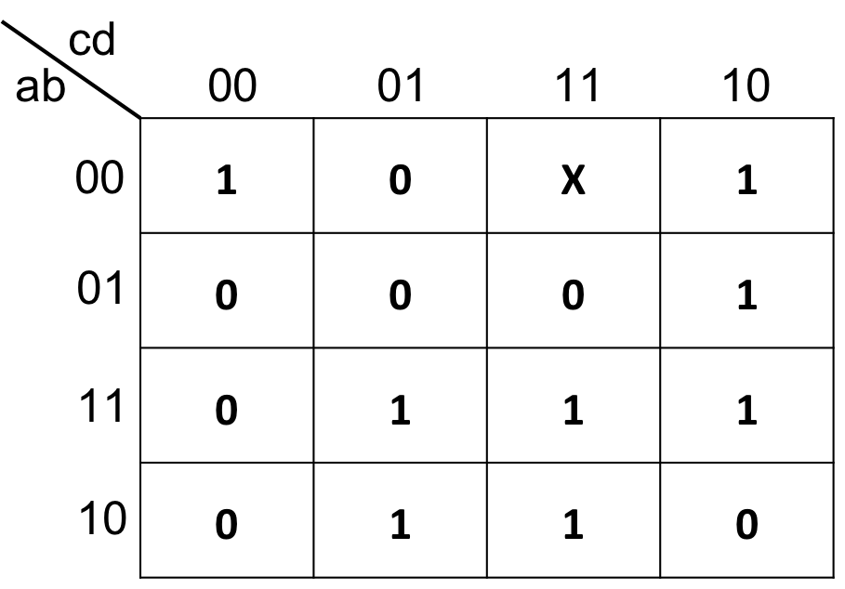
Question (AP)
List all essential prime implicants
  ad, a’b’d’
  ad, a’b’d’, bcd’
  abc, a’cd’
  ad, a’b’d’, bcd’, abc, a’cd’
  ☹

Slide 11
Automated Logic Simplification
Minimizing by hand
  Hard for functions with 5 or more variables
  May not yield minimum cover depending on order we choose
  Is error prone
Minimization thus typically done by automated tools
  See book for details
I
yz
x
00
01
11
10
0
1
1
1
0
(
a
)
1
1
0
1
1
y
’
z
’
x
’
y
’
yz
x
y
4 terms
I
yz
x
00
01
11
10
0
1
1
1
0
(
b
)
1
1
0
1
1
y
’
z
’
x
’
z
x
y
Only 3 terms

Slide 12
K-Map Tool
Xilinx
K-Map explorer program
  http://highered.mcgraw-hill.com/sites/0073380695/student_view0/karnaugh_map_explorer_program.html

Slide 13
Multi-Level Logic Optimization
We don’t always need the speed of two-level logic
  Multiple levels may yield fewer gates
    F1 = abc + abd + acd + ace
    F2 = ab(c + d) + ac(d + e) = a(b(c + d) + c(d + e))
Factor out literals: xy + xz = x(y+z)
a
32 transistors
b
6
2 gate delays
a
c
4
F2
c
4
a
b
6
d
d
e
4
a
4
c
6
d
8
F1
b
24 transistors
4
4 gate-delays
a
c
c
6
4
F2 = a(b(c + d) + c(d + e))
e
d
F1 = abc + abd + acd + ace

Slide 14
Example
Use multiple levels to reduce number of transistors for
  F1 = abcde + abcde’ + abcd’e’
22 transistors
18 transistors
3 gate delays
4 gate delays
a
a
b
8
b
6
c
c
4
F2
d
4
F1
d
a
4
b
d
c
10
4
d
e
e
F1 = abcd + abcd’e’
F2 = abc(d + d’e’)

Slide 15
Exploiting Non-Critical Path
26
t
r
ansistor
s
22
t
r
ansistor
s
3 gate-del
a
y
s
3 gate-del
a
y
s
a
4
a
b
4
4
b
c
4
c
d
6
F1
6
d
4
F2
e
4
e
f
6
f
6
g
g
F1 = (a+b)c +
dfg
+
efg
F2 = (a+b)c +
(d
+
e)fg

Slide 16
Today’s Objectives
To understand the concept of “don’t care” input combinations and how they relates to k-maps
To understand when multi-level logic might be desirable

Slide 17
Question
Draw the appropriate circles on the following k-map
1 | X | 1 | 1
0 | 0 | 0 | 0
0 | X | X | X
1 | 0 | 1 | 1

